Slide 1
Hotel Table Reservation

Slide 2
Problem statement
Build a Hotel Table Reservation as a web application focused primarily on backend development. The system should allow users to search for available tables by selecting a date, time slot, and number of guests, and view available table details including table number, seating capacity, and availability. Users should be able to book a table by providing their name, guest count, desired date and time, and optionally pre-order food items. The billing logic should apply only when food is pre-ordered: the total bill should include the sum of food item prices, a 5% service charge, and 18% GST on the food total. If no food is pre-ordered, the reservation remains free with no charges. Upon booking, the system should display a confirmation summary showing the table details, reservation time, guest count, pre-ordered food summary (if any), and a full breakdown of charges including GST, service charge, and final payable amount.

Slide 3
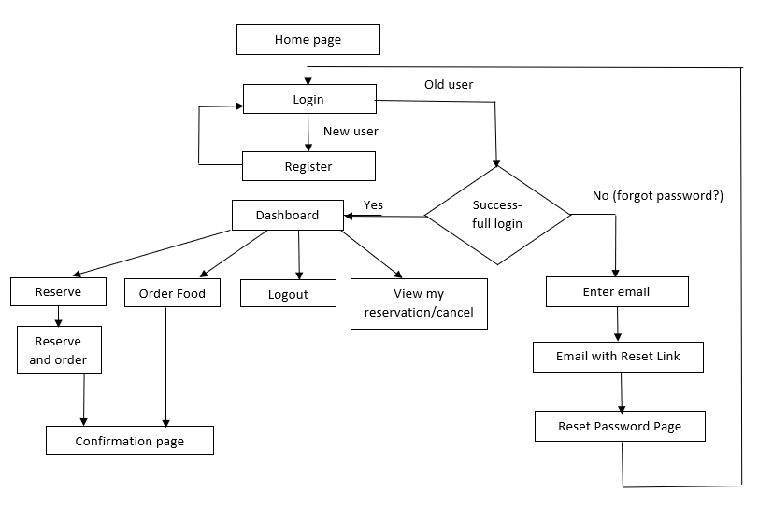
Flow diagram

